Slide 1

Wireless and Mobile Networks
Lecture | CSE421 – Computer Networks
Department of Computer Science and Engineering
School of Data & Science
All material copyright 1996-2023
J.F Kurose and K.W. Ross, All Rights Reserved

Slide 2
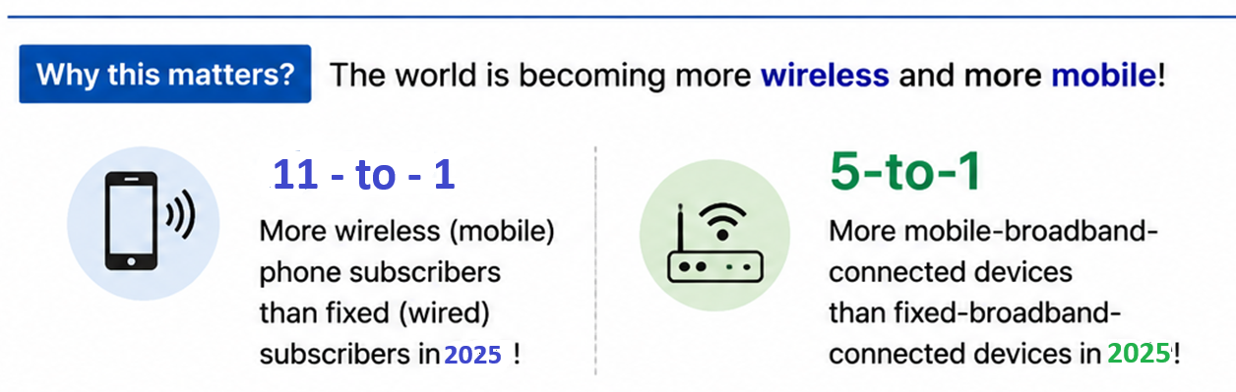
Wireless and Mobile Networks: context

Slide 3

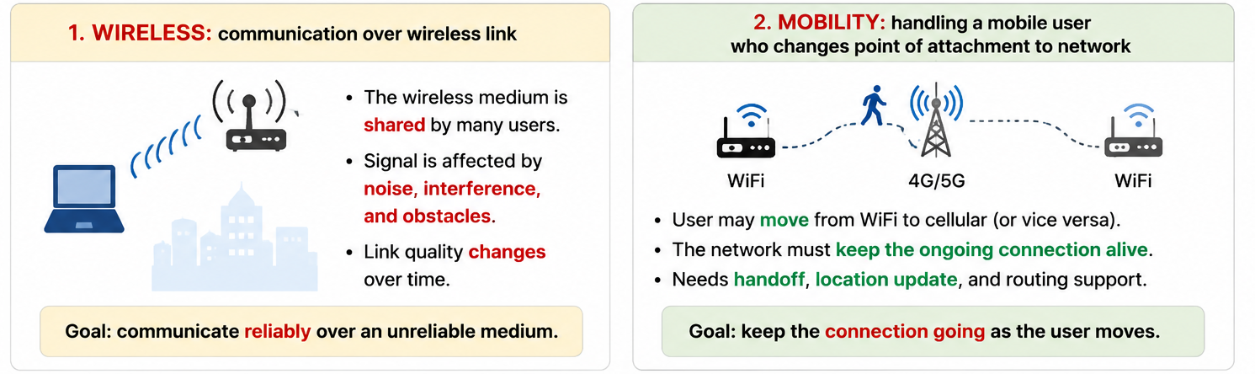
Wireless and Mobile Networks: context
Notes:
more wireless (mobile) phone subscribers than fixed (wired) phone subscribers (10-to-1 in 2019)!
more mobile-broadband-connected devices than fixed-broadband-connected devices devices (5-1 in 2019)!
4G/5G cellular networks now embracing Internet protocol stack, including SDN
two important (but different) challenges
wireless: communication over wireless link
mobility: handling the mobile user who changes point of attachment to network

Slide 4



















Elements of a wireless network
infrastructure mode
base station connects mobiles into wired network
handoff: mobile changes base station providing connection into wired network
wired network
infrastructure

Slide 5





Wi-Fi : 802.11 LAN architecture
wireless host communicates with base station
  base station = access point (AP)
Basic Service Set (BSS) (aka “cell”) in infrastructure mode contains:
  wireless hosts
  access point (AP): base station
ad hoc mode: hosts only
Internet
router
AP1
switch
BSS 1
AP2
AP3
BSS 2
BSS 3

Slide 6
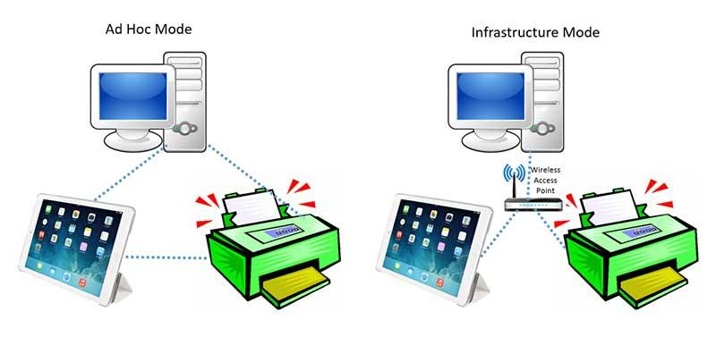
Infrastructure vs Ad Hoc Mode

Slide 7


Wireless link characteristics: hidden terminals
Hidden terminal problem
B, A hear each other
B, C hear each other
A, C can not hear each other means A, C unaware of their interference at B
Attenuation also causes “hidden terminals”
B, A hear each other
B, C hear each other
A, C can not hear each other interfering at B
C
A
B
C
B
A
C’s signal
strength
A’s signal
strength
space

Slide 8
IEEE 802.11: multiple access
Wireless is a shared medium
Multiple transmissions at the same time → collision
CSMA: sense the channel before transmitting
Wireless cannot reliably detect collisions while transmitting
    Hidden terminal
    Signal fading
CSMA/CA: try to avoid collisions goal: avoid collisions: CSMA/CollisionAvoidance

Slide 9
IEEE 802.11 MAC Protocol: CSMA/CA
802.11 sender
1 if sense channel idle for DIFS then
  transmit entire frame (no CD)
sender
receiver
DIFS
2 if sense channel busy then
  start random backoff time
  timer counts down while channel idle
  transmit when timer expires
  if no ACK, increase random backoff interval, repeat 2
data
SIFS
ACK
802.11 receiver
if frame received OK
return ACK after SIFS (ACK needed due to hidden terminal problem)

Slide 10

Collision Avoidance: RTS-CTS exchange
A
B
AP
RTS(A)
RTS(B)
reservation collision
RTS(A)
CTS(A)
CTS(A)
time
DATA (A)
defer
ACK(A)
ACK(A)

Slide 11
802.11: mobility within same subnet
H1 remains in same IP subnet: IP address can remain same
switch: which AP is associated with H1?
  self-learning: switch will see frame from H1 and “remember” which switch port can be used to reach H1
BBS 1
H1
BBS 2

Slide 12
What is mobility?
spectrum of mobility, from the network perspective:
no mobility
high mobility
device moves
Within same AP
device moves within APs in the same network
device moves between different APs but within the same
network
device moves
Between different networks,
while maintaining
ongoing connections
We’re interested in these!

Slide 13
Mobility approaches
Let network (routers) handle it:
  Routers keep track of where each mobile is
  Problem : does not scale to billions of mobile devices
not
scalable
to billions of
mobiles
let end-systems handle it: functionality at the “edge”
  Indirect routing: the packet first goes to the mobile's home network, and then to wherever the mobile is now.”
  Direct routing: the correspondent learns the mobile's current network and sends the packet directly there.

Slide 14

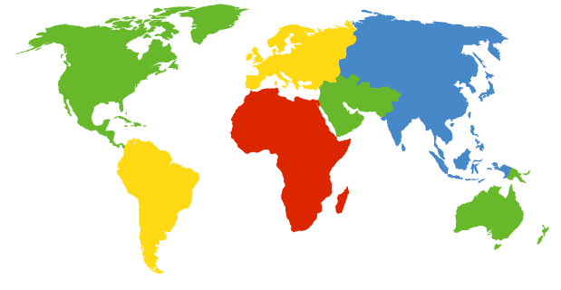

Contacting a mobile friend:
I wonder where Alice moved to?
Imagine your friend keeps changing locations. How do you find them?
search all phone books?
expect her to let you know where he/she is?
call his/her parents?
Facebook!
The importance of having a “home”:
A reliable place that knows about you
A place where people can find out where you are

Slide 15
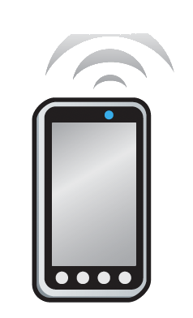
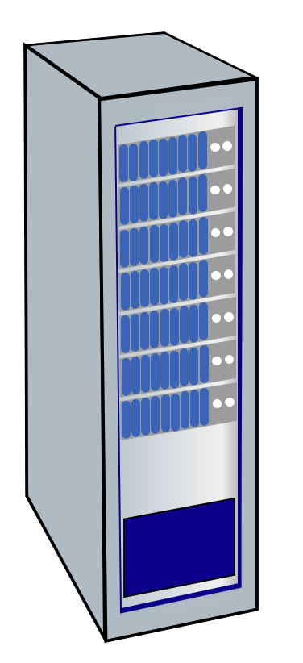

Mobility with indirect routing
Home Network
  e.g.,: 128.119/16
Visited Network
e.g.,: 79.129/16
Permanent IP:
128.119.40.186
IMSI
78:4f:43:98:d9:27
Home
Subscriber
Server
NAT IP:
10.0.0.99
IMSI
78:4f:43:98:d9:27
3
Mobility manager
visited gateway router forwards the packet to the mobile
2
Mobility manager
4a
Visited network gateway
Home network gateway
Home gateway
home gateway receives packet
forwards to visited network
public or private Internet
1
Reply can go back through the home network (4a) OR
directly to the correspondent (4b)
4b
correspondent uses mobile’s home address as destination address
Correspondent

Slide 16
Mobility with indirect routing: comments
Problem : triangle routing:
  Packets take an indirect path:
  Correspondent → Home Network → Mobile
When the mobile moves to a new network:
  Mobile registers with the new network
  The new network informs the home network
  Packets are still forwarded through the home network
  The mobile can keep its existing connections (e.g., TCP)

Slide 17
Mobility with direct routing
Home Network
  e.g.,: 128.119/16
Visited Network
e.g.,: 79.129/16
Permanent IP:
128.119.40.186
IMSI
78:4f:43:98:d9:27
Home
Subscriber
Server
NAT IP:
10.0.0.99
IMSI
78:4f:43:98:d9:27
4
Mobility manager
visited gateway router forwards packet to mobile
Mobility manager
Visited network gateway
Home gateway
2
public or private Internet
3
correspondent asks home network for the mobile’s visited network
1
Correspondent sends packet directly to visited network address
Correspondent

Slide 18
Direct vs. Indirect Routing: Which Is Better?
If you were designing the network, which one would you choose?
Indirect Routing
Direct Routing
Correspondent → Home → Mobile
Correspondent → Mobile
✓
Simple for correspondent
✓
Shorter path
✓
Mobile can move without informing correspondent
✗
Correspondent needs current location
✗
Triangle routing — longer path
✗
More signaling / complexity
Home
Corresp.
Mobile
Corresp.
Mobile
Longer path — triangle routing
Shorter path — direct routing
There is no free lunch!
Simple & transparent ↔ Efficient but more complex

Slide 19
Mobile IP: An Early Solution to the Mobility Problem
Idea: keep a mobile device reachable using its permanent identity, even after it moves
The problem:
A mobile device moves to a different network. How can we still reach it using its permanent IP address?
🏠
📍
📦
Home Agent
Foreign / Visited Network
Tunneling
Keeps track of where the mobile currently is
The network the mobile connects to after it moves
Packets are forwarded from home to the mobile's current location
tunnel
Home Network
Visited Network
📱
The mobile moved. Its location changed. But how can its identity stay the same?

Slide 20
The End
BUT ACTUALLY NOT THE END!

